Slide 1
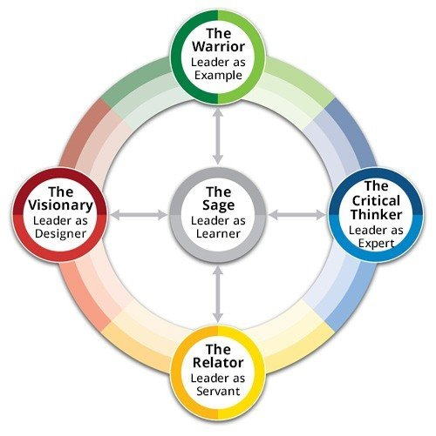

The Five Paths
to Leadership®
Unlock leadership potential—for yourself, your team, and your campus.
In the ever-evolving landscape of higher education, leadership demands adaptability. Achieving this requires a deep understanding of how you and your colleagues show up as leaders and how your behavior changes under stress. The Five Paths to Leadership® Self-Assessment gives you language and a framework to use to improve collaboration and an intuitive tool to help you lean into and strategically embrace other styles when needed. Use it to learn more about yourself, enable better team dynamics, and create a shared language of leadership campus-wide. ​
Assessment Instructions:​
Experience the enlightenment that comes with learning and growing with others. Once you complete the assessment and have your results, we look forward to you joining us for a debrief session. Participating in this session is a great way to experience this content first-hand and gain a better understanding of your own leadership styles. You can also explore further Five Paths topics in our Applying the Model self-paced course.​
Log in to Academic Impressions with the email address from [YOUR INSTITUTION].
  If using SSO, a pop-up will appear through which you will log in with [YOUR INSTITUTIONAL CREDENTIALS].
  If not using SSO, you'll be prompted to create a password.
Take the Five Paths to Leadership® Self-Assessment. The assessment should take about 10 minutes. You can access the assessment here.​
Results will automatically be emailed to you (from webmaster@academicimpressions.com) upon completion of the assessment and will show up in your Academic Impressions account. ​
If you do not receive your results report, please contact us at operations@academicimpressions.com with the name and email address you used to access the assessment for assistance.​
Take the Assessment
QUESTIONS? Reach out to your partner success manager today!
[PSM NAME]
Email: [PSM EMAIL] Phone: [PSM PHONE] ​

Slide 2
Slide Overview: The Five Paths to Leadership®
This slide introduces employees to the Five Paths to Leadership® self-assessment, outlining how they can take the assessment and access their personalized results.
Customization Instructions
Before sharing the slide, make sure to complete the following steps:
1. Update Bracketed Text
Replace all placeholders in brackets with the appropriate details:
•[YOUR INSTITUTION]
•[YOUR INSTITUTIONAL CREDENTIALS] (e.g. email login or single sign-on)
2. Add Partner Success Manager Information
Insert the name, email address, and phone number of your institution’s Partner Success Manager.
•Not sure who your Partner Success Manager is?
Contact Roshaon Tytar at roshaon@academicimpressions.com for assistance.

